Slide 1
Team K
Design Methodologies
James Wilson
Kritika Nautiyal
James Gormley

Slide 2

Design Methodologies

Slide 3
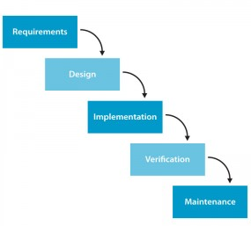
Waterfall Model

Slide 4

When?
Clear fixed
requirements
Product definition
is stable.
The project is short.

Slide 5
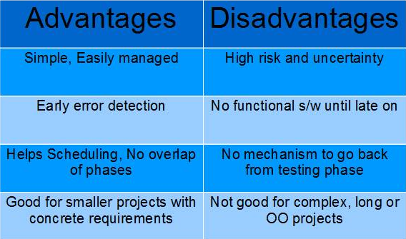
Waterfall Model

Slide 6
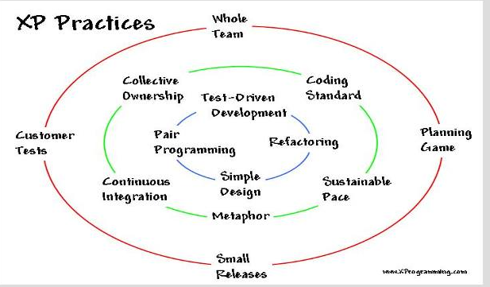
Extreme Programming

Slide 7
When?
Changeable requirements
Agile approach needed
Small to medium size staff
The customer is on site

Slide 8
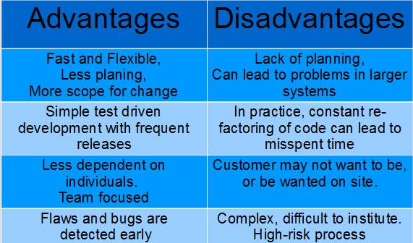
Extreme Programming

Slide 9
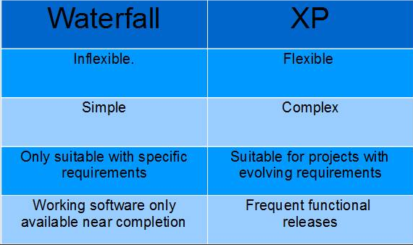
Comparison

Slide 10

Questions?

